Slide 1
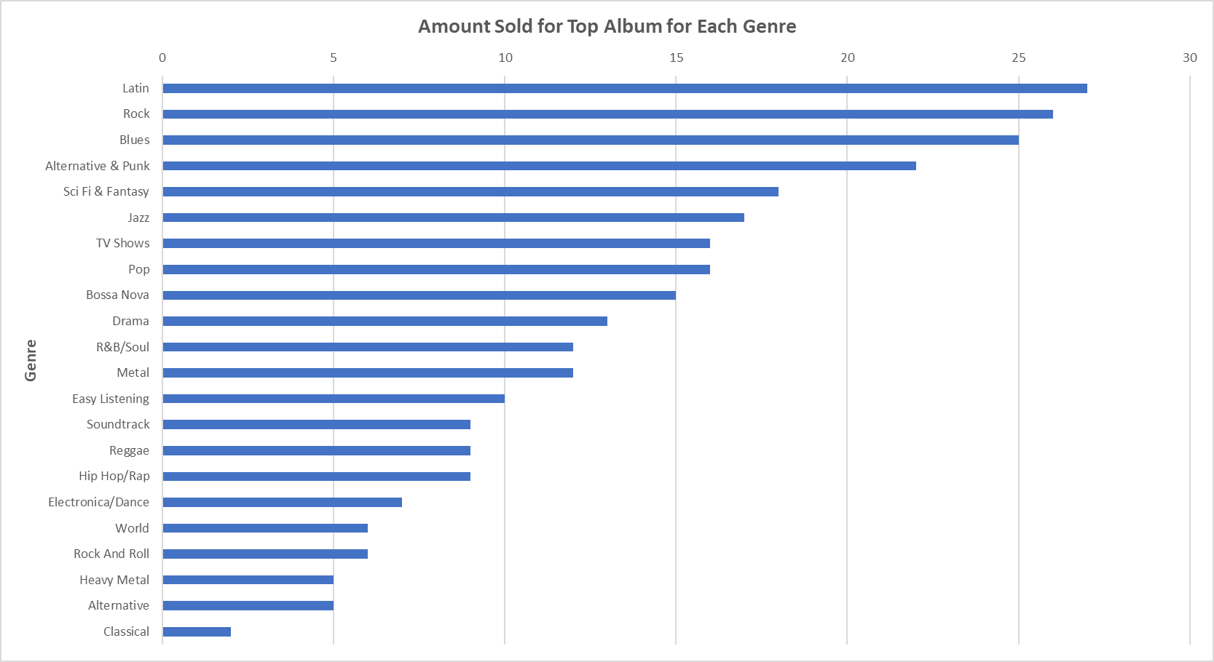
How many of the most popular albums were sold from each genre?
From the chart we are able to see that the most popular albums come from the Latin, Rock, and Blues genre, while the least popular genre is Classical

Slide 2
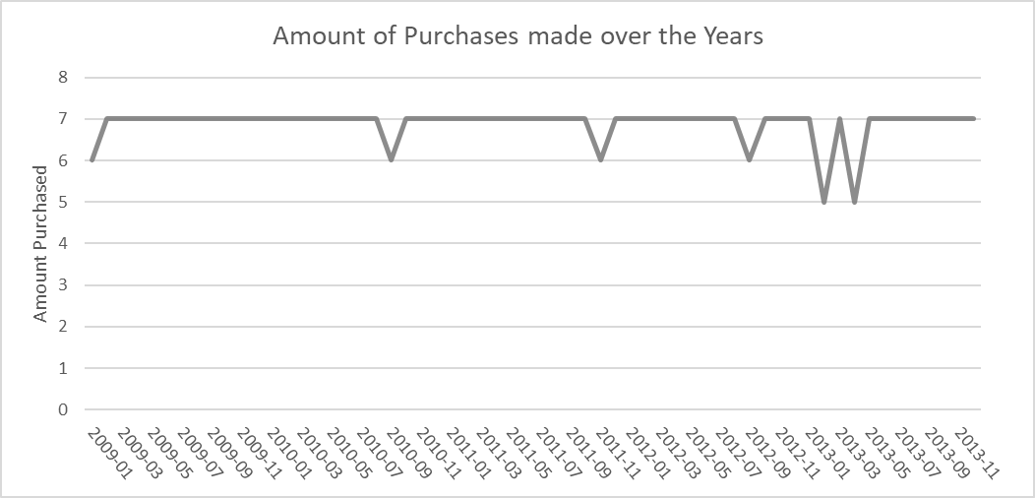
Are the purchases made fairly consistent throughout the years?
From the line chart we can safely conclude that the amount of purchases made were fairly consistent over the years.

Slide 3
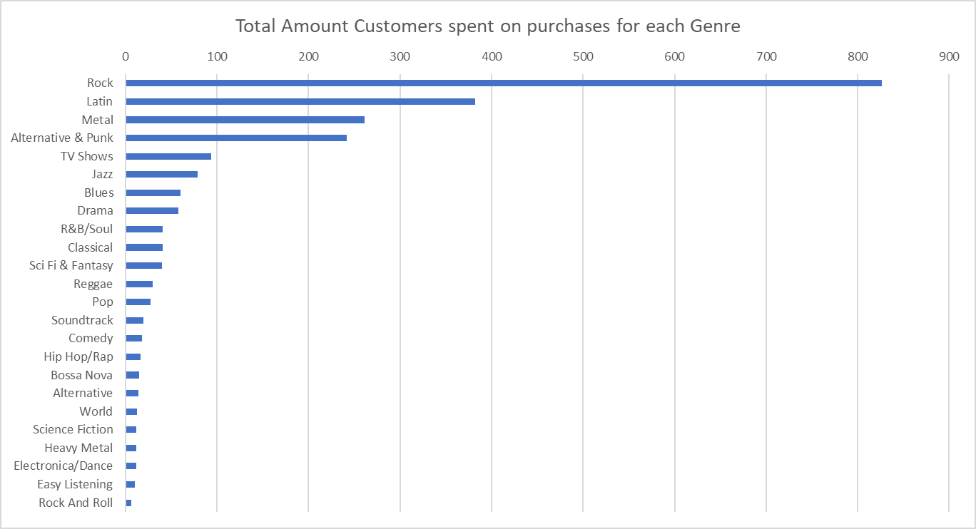
How much did the customers spend in total for each genre?
From the chart we are able to conclude that Rock was the most popular genre and outsold every other genre by a huge amount. Rock sold 50% more than the second most sold genre, Latin.

Slide 4
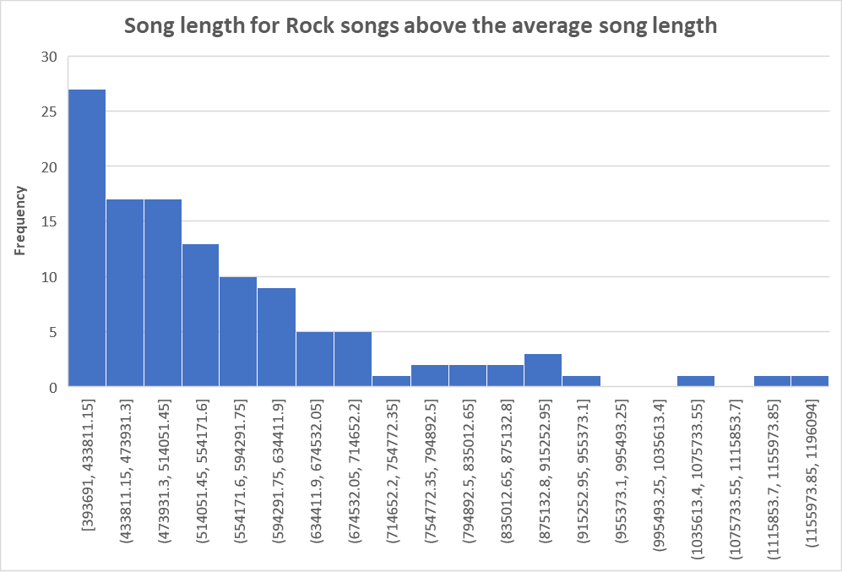
What is the distribution of song lengths from the rock genre above the average song length across all genres?
The graph is skewed to the right, aka. Positively skewed, means are greater than the median.
A majority of the songs in the rock genre are drastically longer than the average length of a song.

